Slide 1
What is Classification
Classification is a predictive method
Classification predicts categorical class labels (discrete or nominal)
Classification is a supervised method and the model is constructed using a training data set
The model is then used to classify new data
Some applications
Credit approval – high vs low risk
Targeted marketing – loyal vs non-loyal customers
Medical diagnosis – cancerous vs benign cells
Fraud – genuine vs fraudulent transactions

Slide 2
Classification Example 1
Class A Examples
Class B Examples
A or B?
4 4
5 2.5
5 5
2 5
8 1.5
6 6
5 3
3 3
2.5 3
7 7

Slide 3
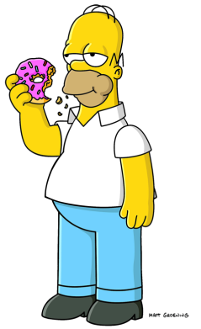
Classification Example 1
Class A Examples
Class B Examples
Equal size bars ⇒ A
Otherwise B.
4 4
5 2.5
5 5
2 5
8 1.5
B
6 6
5 3
3 3
2.5 3
7 7
A

Slide 4
Classification Example 2
Class A Examples
Class B Examples
A or B?
4 4
5 6
1 5
7 5
6 6
6 3
4 8
2 7
7 7

Slide 5

Classification Example 2
Class A Examples
Class B Examples
Doh!
4 4
5 6
1 5
7 5
6 6
6 3
4 8
2 7
7 7

Slide 6

Classification Example 2
Class A Examples
Class B Examples
(Sum of bars) ≤10 ⇒ A
Otherwise B.
4 4
5 6
1 5
7 5
6 6
B
6 3
4 8
2 7
7 7

Slide 7
Geometric Interpretation of Classification: Example 1
Class A Examples
Class B Examples
Left = Right
10
4 4
5 2.5
9
8
7
6
5 5
2 5
5
Left Bar
4
3
2
6 6
5 3
1
1
2
3
4
5
6
7
8
9
10
Right Bar
3 3
2.5 3

Slide 8
Geometric Interpretation of Classification: Example 1
Class A Examples
Class B Examples
Left + Right = 10
10
4 4
5 6
9
8
7
6
1 5
7 5
5
Left Bar
4
3
2
6 3
4 8
1
1
2
3
4
5
6
7
8
9
10
Right Bar
2 7
7 7

Slide 9
Supervised vs Unsupervised Learning
Machine Learning - Field of study that gives computers the ability to learn without being explicitly programmed (Samuel 1959)
Supervised Learning
The computer is presented with inputs (independent variables) and associated labels indicating the class of the observation (dependent variable)
The computer attempts to learn the rule that maps inputs to each class
New data is classified based on the rule learned by the computer
Unsupervised Learning
The computer is presented only with inputs (independent variables)
The computer attempts to classify things based on similarity/dissimilarity

Slide 10
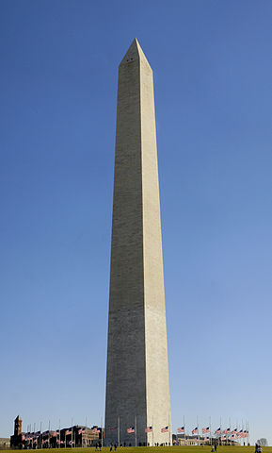

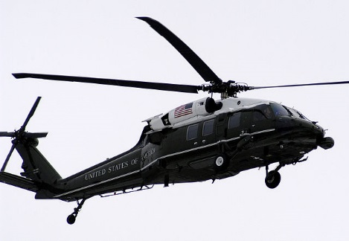


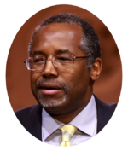




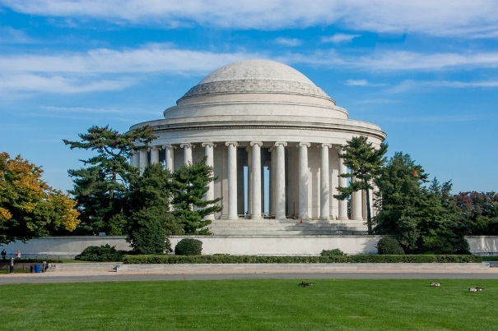

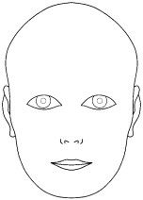
Supervised Learning Example
Independent Variable Dependent Variable
Rule
Face
If then Face, else Not Face
Not Face

Slide 11




Unsupervised Example
Class = ?
Class = ?

Slide 12
Classification Terminology
Inputs: Predictors or Independent Variables
Outputs: Responses or Dependent Variables
Classification techniques → categorical outputs
Regression (or variants thereof) techniques → continuous outputs
Models: Classifiers
Models predict an output given a set of inputs

Slide 13
The Classification Process: Model Building
Training Data
Name | Rank | Years | Tenured?
Mike | Assistant Prof | 3 | No
Mary | Assistant Prof | 7 | Yes
Bill | Professor | 2 | Yes
Jim | Associate Prof | 7 | Yes
Dave | Assistant Prof | 6 | No
Anne | Associate Prof | 3 | No
Classification
Algorithms
Classifier
IF rank = ‘professor’ OR years > 6
THEN tenured = ‘yes’

Slide 14
The Classification Process: Validation
Validation Data
Classifier
IF rank = ‘professor’ OR years > 6
THEN tenured = ‘yes’
Name | Rank | Years | Tenured?
Tom | Assistant Prof | 2 | No
Melissa | Associate Prof | 7 | No
George | Professor | 5 | Yes
Joseph | Assistant Prof | 7 | Yes
Validation Data: helps choose from among different classifiers
Testing Data: Estimates future performance of classifier

Slide 15
The Classification Process: Application
New/Unseen Data
Classifier
IF rank = ‘professor’ OR years > 6
THEN tenured = ‘yes’
Name | Rank | Years | Tenured?
Earl | Professor | 9 | ?
Barry | Associate Prof | 8 | ?
Steve | Professor | 7 | ?
Ian | Assistant Prof | 3 | ?
New Data: Only input information is available

Slide 16
Decision Trees
A series of nested tests
Each node represents a test on one attribute
Each leaf is a class assignment
Once developed, the tree can be used to classify new instances

Slide 17
Decision Trees
Balance
Name | Balance | Age | Default
Mike | 23,000 | 30 | Yes
Mary | 51,000 | 40 | Yes
Bill | 68,000 | 55 | No
Jim | 74,000 | 46 | No
Dave | 23,000 | 47 | Yes
Anne | 100,000 | 49 | No
<50K
>=50K
Default
Age
>45
<=45
Not Default
Default

Slide 18
Decision Trees
Balance
Name | Balance | Age | Default
Mark | 88,000 | 40 | ?
<50K
>=50K
Default
Age
>45
<=45
Not Default
Default

Slide 19
Decision Tree Construction
Basic algorithms are greedy, make locally optimum decisions
Tree constructed in a top-down recursive divide-and-conquer manner
All training examples are at the root initially
Attributes are assumed to be categorical (discretized if necessary)
Examples partitioned recursively based on selected attributes
Test attributes selected based on a heuristic or statistical measure

Slide 20
Decision Tree Algorithms
Common approaches are ID3 (Quinlan 1986), C4.5 (Quinlan 1993), CaRT (Breimanetal 1984)
For each node
Identify the best attribute to split the data
For each value of the attribute, create a new child node
Allocate the observations to the appropriate child node
For each child node
If node is pure, STOP
Else, recursively call the algorithm to split again
← How?

Slide 21
Selecting the Best Attribute for Splits
Outlook | Temp | Humidity | Windy | Play?
Sunny | Hot | High | False | No
Sunny | Hot | High | True | No
Overcast | Hot | High | False | Yes
Rainy | Mild | High | False | Yes
Rainy | Cool | Normal | False | Yes
Rainy | Cool | Normal | True | No
Overcast | Cool | Normal | True | Yes
Sunny | Mild | High | False | No
Sunny | Cool | Normal | False | Yes
Rainy | Mild | Normal | False | Yes
Sunny | Mild | Normal | True | Yes
Overcast | Mild | High | True | Yes
Overcast | Hot | Normal | False | Yes
Rainy | Mild | High | True | No
Task: Develop a decision to predict if John will play tennis
9 Yes
5 No
14 Total

Slide 22
Which Attribute to Select?
Outlook
Temp
Sunny
Rainy
Hot
Cool
Overcast
Mild
2 Yes
3 No
3 Yes
2 No
2 Yes
2 No
3 Yes
1 No
4 Yes
4 Yes
2 No
Humidity
Windy
High
Normal
False
True
3 Yes
4 No
6 Yes
1 No
6 Yes
2 No
3 Yes
3 No

Slide 23
A Criterion for Attribute Selection
A heuristic for attribute selection is simply to choose the attribute that minimizes the number of splits in the tree
However, it would be nice to have a measure to identify the best attribute
Selecting the best attribute largely involves assessing certainty
For a node with 4 Yes/0 No or 0 Yes/4 No, we are relatively certain
For a node with 2 Yes/2 No, we are not certain at all
So for pure nodes, we are very certain and for impure nodes we are not
A popular (im)purity criterion is information
This is the extra information needed to classify and instance
It takes a low value of information for pure nodes and a high value for impure nodes
Strategy: Choose the attribute that results in the greatest information gain
Information gain is the commonly used approach
It is equivalent (and faster) to select the smallest total weighted entropy

Slide 24
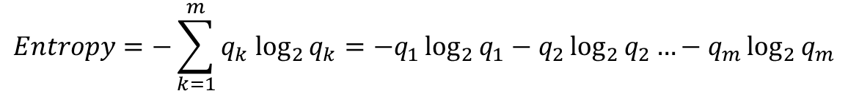
Computing Entropy
Entropy is the information required to predict an event
Information is measured in bits
Entropy represents the additional required information (i.e., the information deficit) in bits
Where
m is the number of classes
q_{k} is the proportion of records belonging to class k
$$Entropy=−\sum_{k=1}^{m}{q_{k} \log_{2}{q_{k}}}=−q_{1}\log_{2}{q_{1}}−q_{2}\log_{2}{q_{2}}…−q_{m}\log_{2}{q_{m}}$$

Slide 25



Computing Entropy
Outlook = “Sunny”
Outlook = “Overcast”
Outlook = “Rainy”
Total weighted entropy for attribute Outlook:
Outlook
$${Entropy}_{Sunny}=−\frac{2}{5}\log_{2}{\frac{2}{5}−\frac{3}{5}\log_{2}{\frac{3}{5}}}=0.971 bits$$
Sunny
Rainy
Overcast
2 Yes
3 No
3 Yes
2 No
$${Entropy}_{Overcast}=−\frac{4}{4}\log_{2}{\frac{4}{4}−\frac{0}{4}\log_{2}{\frac{0}{4}}}=0 bits$$
4 Yes
$${Entropy}_{Rainy}=−\frac{3}{5}\log_{2}{\frac{3}{5}−\frac{2}{5}\log_{2}{\frac{2}{5}}}=0.971 bits$$
$${TWE}_{Outlook}=\frac{5}{14}⋅0.971+\frac{4}{14}⋅0+\frac{5}{14}⋅0.971=0.693 bits$$

Slide 26
Comparing Total Weighted Entropies
Given the following total weighted entropies, which attribute should we split on?
$${Total Weighted Entropy}_{Outlook}=0.693 bits$$
Outlook has the smallest total weighted entropy (i.e. it requires the least amount of additional information to be sure of a prediction)
$${Total Weighted Entropy}_{Temperature}=0.911 bits$$
$${Total Weighted Entropy}_{Humidity}=0.788 bits$$
$${Total Weighted Entropy}_{Windy}=0.892 bits$$

Slide 27










Another Example
Person | Hair Length | Weight | Age | Class
Homer | 0” | 250 | 36 | M
Marge | 10” | 150 | 34 | F
Bart | 2” | 90 | 10 | M
Lisa | 6” | 78 | 8 | F
Maggie | 4” | 20 | 1 | F
Abe | 1” | 170 | 70 | M
Selma | 8” | 160 | 41 | F
Otto | 10” | 180 | 38 | M
Krusty | 6” | 200 | 45 | M
Comicbook Guy | 8” | 290 | 38 | ???

Slide 28



Splitting on Hair Length
$${Entropy}_{≤5}=−\frac{1}{4}\log_{2}{\frac{1}{4}−\frac{3}{4}\log_{2}{\frac{3}{4}}}=0.811 bits$$
$${Entropy}_{>5}=−\frac{3}{5}\log_{2}{\frac{3}{5}−\frac{2}{5}\log_{2}{\frac{2}{5}}}=0.791 bits$$
Hair Length ≤ 5”
Hair Length > 5”
$${TWE}_{Hair Length}=\frac{4}{9}⋅0.811+\frac{5}{9}⋅0.791=0.800 bits$$
1F, 3M
3F, 2M

Slide 29



Splitting on Weight
$${Entropy}_{≤160}=−\frac{4}{5}\log_{2}{\frac{4}{5}−\frac{1}{5}\log_{2}{\frac{1}{5}}}=0.722 bits$$
$${Entropy}_{>160}=−\frac{0}{4}\log_{2}{\frac{0}{4}−\frac{4}{4}\log_{2}{\frac{4}{4}}}=0 bits$$
Weight ≤ 160
Weight > 160
$${TWE}_{Weight}=\frac{5}{9}⋅0.722+\frac{4}{9}⋅0=0.401 bits$$
4F, 1M
0F, 4M

Slide 30



Splitting on Age
$${Entropy}_{≤40}=−\frac{3}{6}\log_{2}{\frac{3}{6}−\frac{3}{6}\log_{2}{\frac{3}{6}}}=1.0 bits$$
$${Entropy}_{>40}=−\frac{1}{3}\log_{2}{\frac{1}{3}−\frac{2}{3}\log_{2}{\frac{2}{3}}}=0.918 bits$$
Age ≤ 40
Age > 40
$${TWE}_{Age}=\frac{6}{9}⋅1.0+\frac{3}{9}⋅0.918=0.937 bits$$
3F, 3M
1F, 2M

Slide 31
Building the Tree
Splitting on weight yields the lowest TWE (0.401 bits vs 0.800 bits or 0.937 bits)
The weight ≤ 160 node is not pure, therefore recurse
At the next level, split on hair length ≤ 2 is best
Weight ≤ 160
Weight > 160
Hair Length ≤ 2”
Hair Length > 2”

Slide 32
Trees Easily Converted to Rules
IF (Weight > 160) THEN Male
ELSE IF (Hair Length ≤ 2”) THEN Male
ELSE Female
So what about Comicbook Guy?
Hair Length: 8”
Weight: 290
Age: 38
Class:
Weight ≤ 160
Weight > 160
Hair Length ≤ 2”
Hair Length > 2”
Male

Slide 33
Overfitting
Too flexible
Not flexible enough
A naïve modeler might assume that the most complex model should always outperform the others, but this is not the case. An overly complex model might be too flexible. This will lead to overfitting – accommodating nuances of the random noise in the particular sample (high variance). A model with just enough flexibility will give the best generalization.

Slide 34
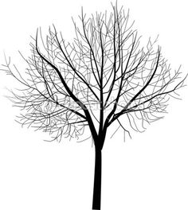
Overfitting Trees
In the context of decision trees, overfitting occurs when
the tree has too many branches
You end up fitting noise
Great fit for training data, poor accuracy for unseen samples
Avoiding Overfitting
Pre-pruning (Stunting)
Stop splitting if the number of cases in a node falls below a
specified limit
Stop splitting if the split is not statistically significant at a specified level
It is difficult to choose a criterion
Post-pruning
Remove branches from a “fully grown” tree
Select from a sequence of progressively pruned trees

Slide 35
Some Common Issues
Learning things that aren’t true
Patterns may not represent any underlying rule or the rule may be obscure event where a relationship is known to exist (vanilla ice cream → car trouble)
Self-selection bias – 97% of eBay online reviews are positive
Data may be at the wrong level of detail – Simpson’s paradox
Learning things that are true, but not useful – Most rules learned are normal business rules (already known)
Data integrity issues

Slide 36
Strengths and Weaknesses
Strengths
Weaknesses
Easily interpreted
Easy to implementation
Relatively efficient
Can handle mixed measurement scales
Can handle missing values
Relatively robust
Extremely popular
Volatile
Sensitive to outliers
Can result in large error

